Slide 1
ALL-CAMPUS MEETING
September 11, 2024

Slide 2
WELCOME

Slide 3
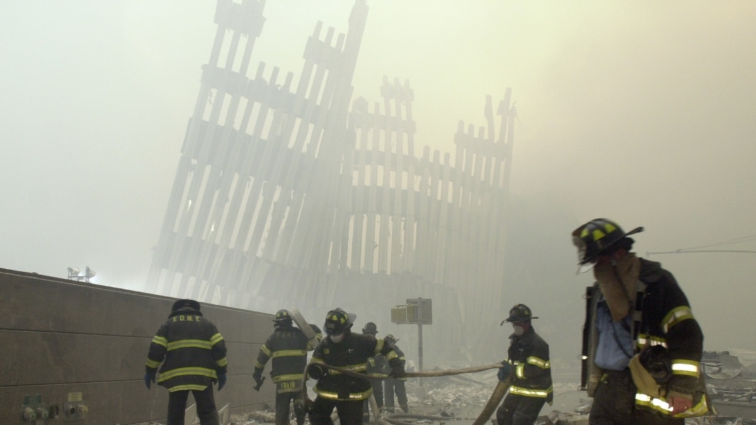
MOMENT OF SILENCE
NY DC PA

Slide 4
REFLECTIONS

Slide 5
SHARING / CARING/ SUPPORT

Slide 6
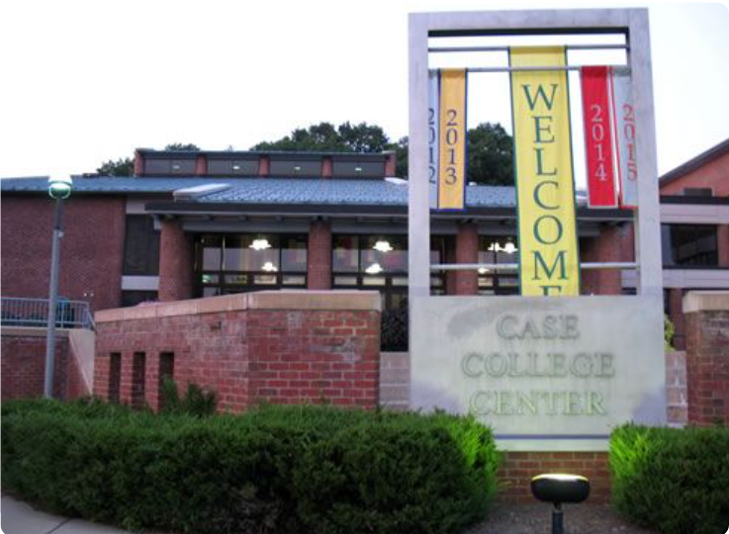
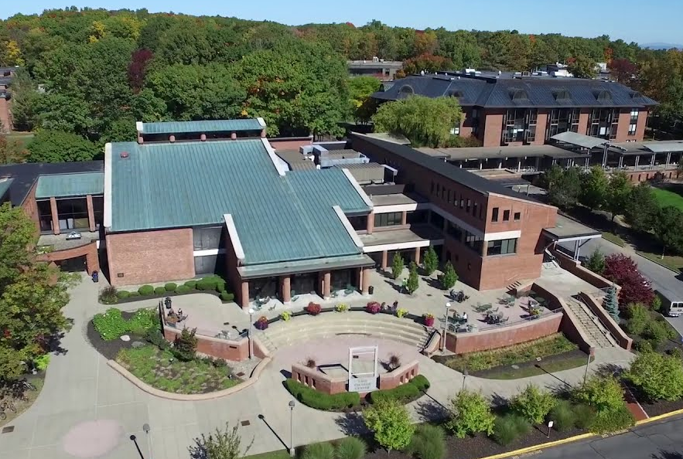
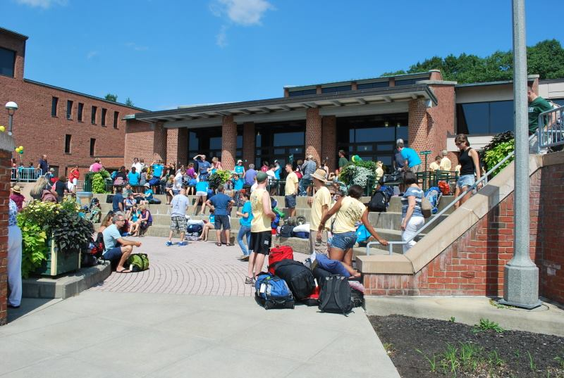
SKIDMORE
COLLEGE

Slide 7
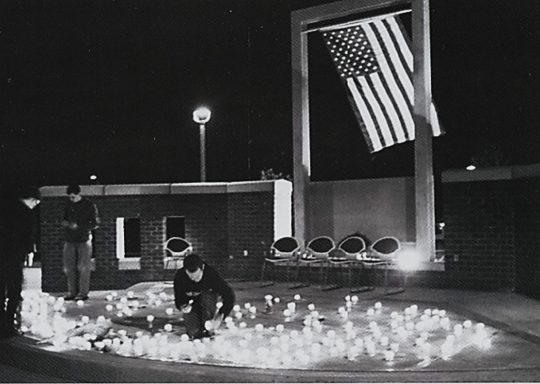
COMING TOGETHER…

Slide 8
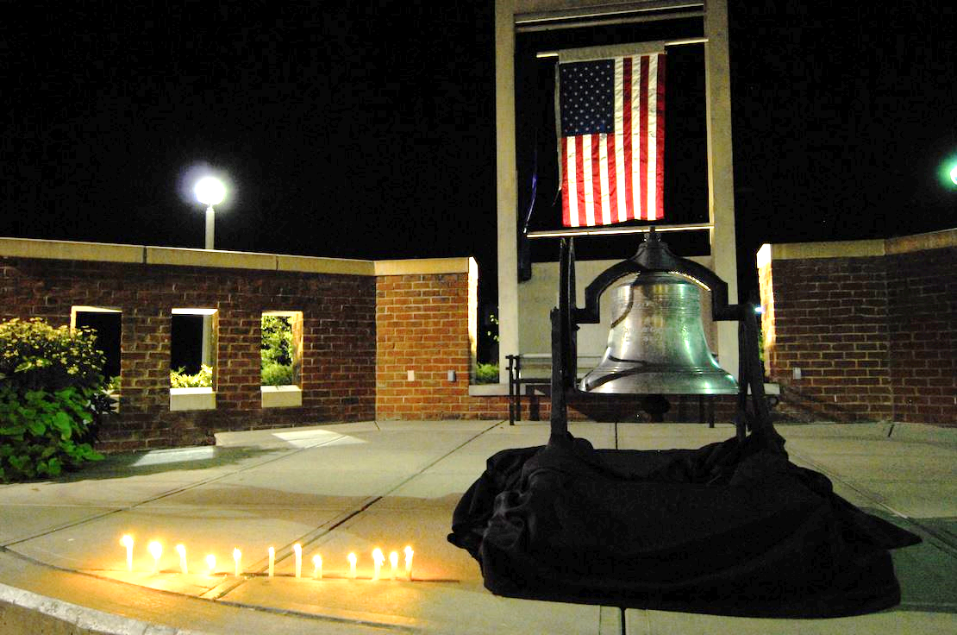

Slide 9
COMING TOGETHER…
9/11 Police & Firefighter Families Community Respite Program

Slide 10
COMING TOGETHER…

Slide 11
REFLECTIONS

Slide 13
CAMPUS OPERATIONS
CAMPUS SECURITY
MEDIA SERIVES
IT SERVICES
FACILTIES SERVICES
BUSINESS OFFICE
BOOKSTORE
FOOD SERVICES
CAPITAL PROJECTS

Slide 14
CAMPUS SECURITY
Student & Faculty ID’s
Lockers assigned
Scan in & Scan out at the Kiosks
Evening Building Closure

Slide 15
CAMPUS SECURITY
Accessible Parking
AEDs, Narcan, First Aid Kits
Security Tip: Use an Asnuntuck phone vs mobile phone to call 911

Slide 16
MEDIA SERVICES
(Video link https://www.youtube.com/watch?v=Fbq66guROr0)
Auditorium Upgrades
STATS
Hy-Flex classrooms
Prioritizing classrooms for upgrades this year

Slide 17
IT SERVICES
OUR NEW LOCATION
Ticket Statistics
Migration Statistics
uni-FLOW Printing

Slide 18
IT SERVICES
New Laptops
OCTOBER: Cyber-security Awareness
Windows 11

Slide 19
BUSINESS OFFICE
BUDGET CHALLENGES
EVENTS & ROOM RESERVATIONS
SHRED-FEST
GIVE ME YOUR TIRED, YOUR POOR…
your huddled masses of old junky furniture, yearning for your offices to breathe free.
Send us the wretched refuse of your teeming shore via email at AS-Maint-Request.

Slide 20
FACILITIES SERVICES
STAFFING – OUR OPERATIONS TEAM:
ANNE BROOKS JONATHAN ROBINSON
LUIS HOMES
(OPEN POSITION)
ANDRES PINEDA (SMG)
BEATRIZ SARMIENTO (ABM)
SHIRLEY TYLER
MARK ERICKSON
JOE MULLER

Slide 21
FACILITIES SERVICES
STATS: PMs, Wos, Project REQUESTS
REQUESTS MAY BE LIMITED
By Budget
By available labor
By priorities
WINDOW HARDWARE
PEST CONTROL

Slide 22
FACILITIES SERVICES
HVAC - CLASSROOM Upgrades
EV PARKING SPACES
ACCESSIBILITY – Annual Testing - Door & Exit Hardware
PLEASE EMAIL “AS-Maint-Request”

Slide 23
BOOKSTORE
Statistics - Transactions
BOOKS - NEW, RENTALS, DIGITAL BOOKS
OTHER MERCHANDISE – Trending
FINANCIAL AID CLOSING DATE
VERIFY ADOPTIONS - JULY 1 & Dec 1

Slide 24
FOOD SERVICES
NEW MENU ITEMS
Soups, Pasta, Chicken Parmesan, Frozen Drinks
STATS – Swipe in & Swipe Out at Kiosks - Need Good Data
This Semester busier than last
70-80 customers per day now, compared to 50-60 last year
CONSIDERING EXTENDED HOURS
SPECIAL – THURSDAYS: Free Beverage Can with 8” Grinder

Slide 25
CAPITAL PROJECTS
Asphalt Repairs
Line re-striping
Accessible Parking –
We Exceed Minimum # of Required Spaces Relocating Spaces Closer to Entries
Signage & DIRECTORIES

Slide 26
CAPITAL PROJECTS
Window Shades for SCIENCE Labs
Shades, Blinds, Film For other areas
HVAC - PHASE 3B & PHASE 4
MANUFACTURING – 139 Offices, Classrooms, 141A MECHATRONICS,
142 ELECTRO-MECHANICAL , Dehumidification
New Boiler Room – for Welding LAB 138
AMTC PROJECTS – ENTRY, LOADING DOCK, 420

Slide 27
CAPITAL PROJECTS
Space Planning – ie Vacancy: 149 (Former IT Offices)
Looking for Spatial Needs
Looking for Ideas
Need Input
College Council Musical Chairs

Slide 28
NOTICES & UPDATES…
CEO
ACADEMIC AFFAIRS
STUDENT DEVELOPMENT
ADVANCED MANUFACTURING
INSTITUTIONAL RESEARCH

