Slide 1
CARE Team
First Semester Highlights

Slide 2
Your CARE Team Members
Dawn Bryden
Ayan Dirir
Paul Felici
Michele Howard-Swan
Amy Koehler
Sherry Paquette
Emily Santaniello
Tim St. James
Kellie Payne
Jillian Sullivan

Slide 3
BIT Becomes CARE
“
Based on feedback at our NABITA meeting last year, it was decided to rename BIT (Behavioral Intervention Team) to CARE

Slide 4
CARE Referral Lifespan
From data input to review and action plan
All concerns must come to the CARE Team through a report
Weekly Team Meetings
Review/Action/Follow up
CARE Action Steps are Established
Follow up/Monitored/Resolve/Reopen

Slide 5
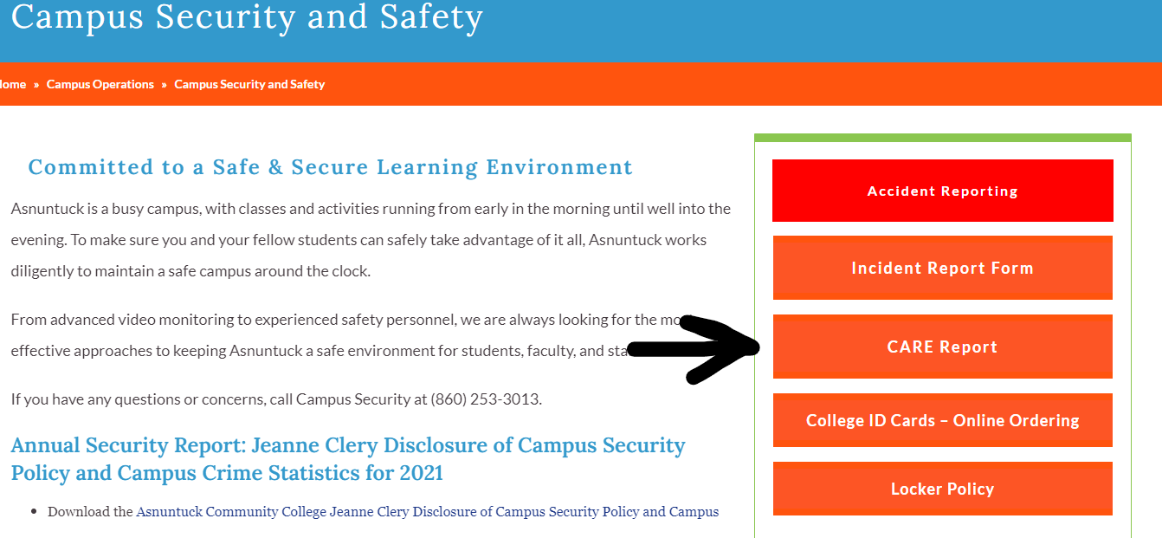
Ways to submit a CARE Report
Asnuntuck Website (Campus Safety & Security Page)

Slide 6
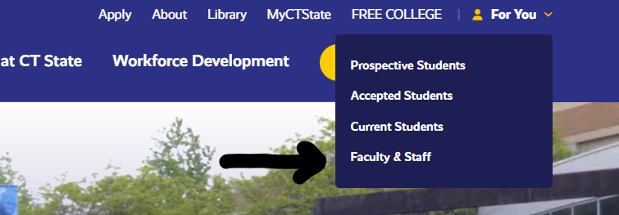
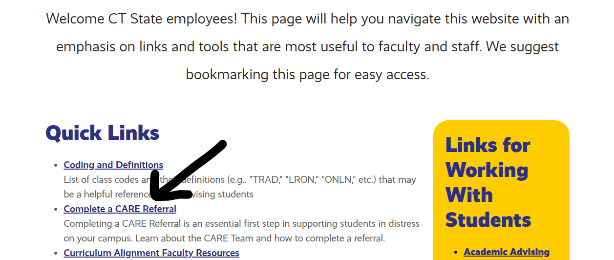
Ways to submit a CARE Report
CT State Website (Faculty & Staff “For You” Dropdown)

Slide 7
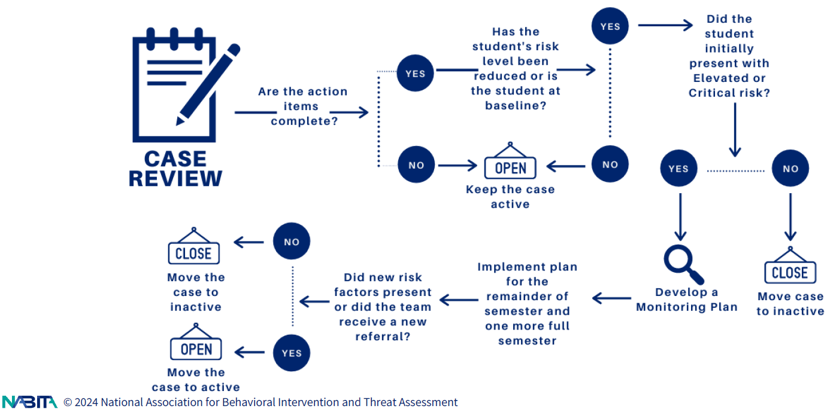
Case Review

Slide 8
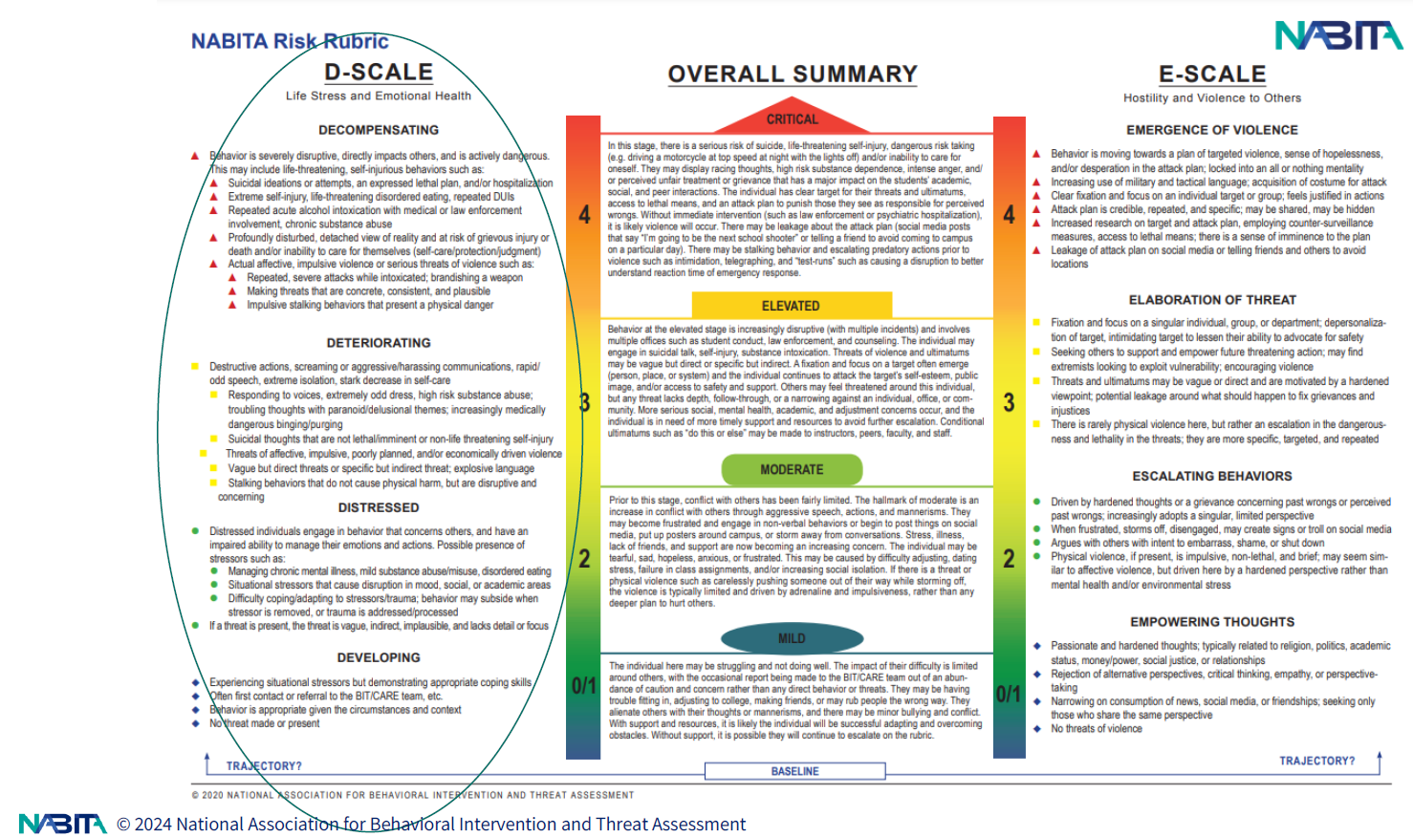
NABITA Risk Rubric

Slide 9
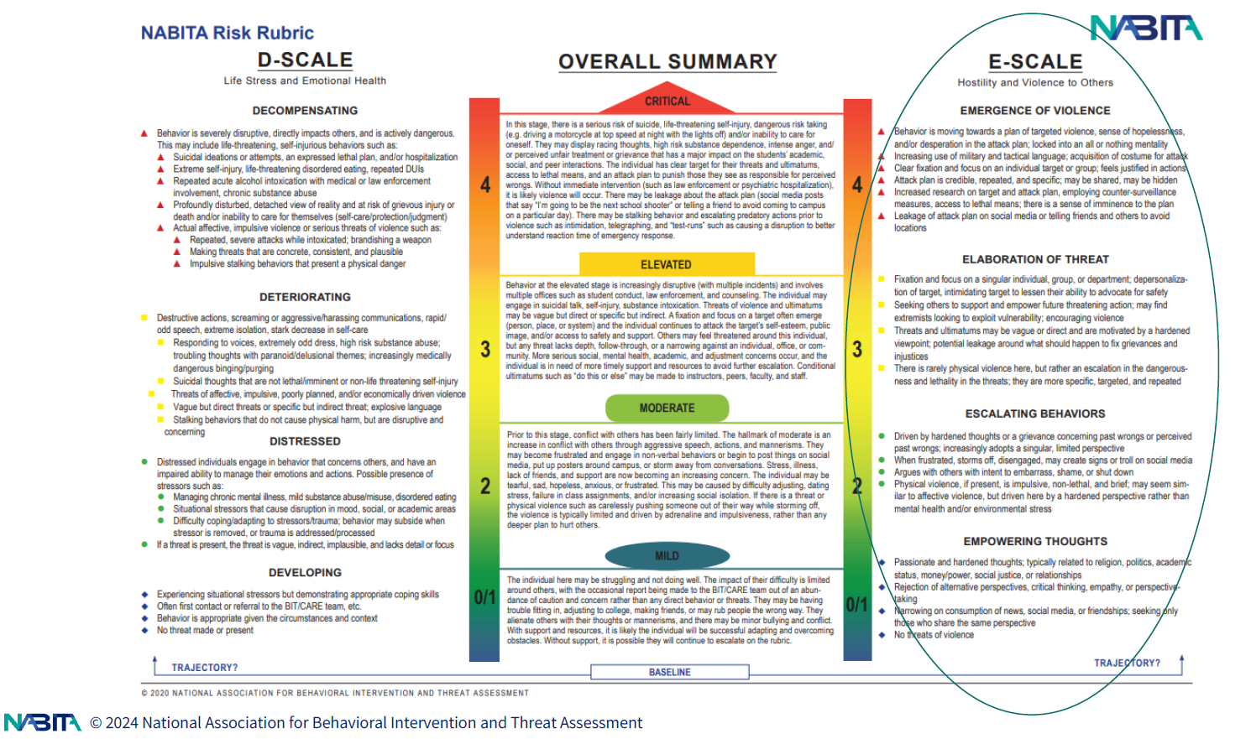
NABITA Risk Rubric

Slide 10
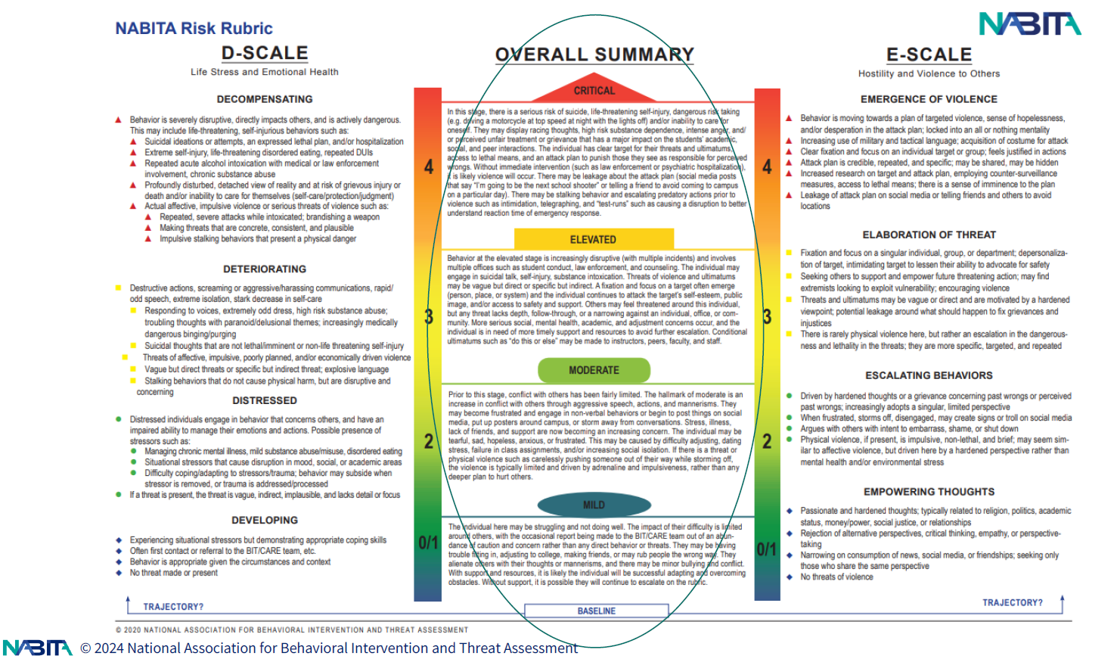
NABITA Risk Rubric

Slide 11
Outreach

Slide 12
Total (statewide) CARE Referrals Submitted
August 25 - December 31
Mental Health
Basic Needs
Other
Behavioral
Medical
Classroom Disruption
Physical Endangerment
57%
26%
20%
10%
9%
8%

Slide 13
Mild
Moderate
63%
27%
NABITA Score for Reporting
(statewide)
Elevated
Critical
5%
.5%

Slide 14
Our Statistics
Fall ’23 (August 25-December 31)
Initial NABITA Score for Reporting
25
8
9
3
1
Total Referrals
Coded Mild (0/1)
Coded Moderate (2)
Coded Elevated (3)
Coded Critical (4)
CARE Referral Concern Category
3
3
8
3
11
4
Basic Needs Concern
Classroom Disruption Concern
Other Behavioral Concern
Medical Concern
Mental Health
Physical Endanger-ment

Slide 15
When in Doubt, Submit a CARE Report
Submitting a report is the best first step to help a student.
Remember “SOLD Out” when filing a report.
Avoid using:
Stereotypes
Opinions
Labels (race, gender)
Diagnostic Characteristics

Slide 16
Thank You

