Slide 1
Asnuntuck Finance Discussion April 9, 2025

Slide 2
Agenda
Midyear Spending Plan & Reallocation of Funding
CSCU Hiring Freeze
Academic Classroom Supplies Project
Update & Analysis of Governor’s Recommended Biennial Budget
Five Year Fiscal Sustainability Plan

Slide 3
I. FY 25 Midyear Budget
Original FY 25 Board adopted budget resulted in a $2.2M shortfall
Multiple State revenue changes & Board approved increased expenditures for Restoration of Student Facing Services yields a revised FY 25 budget with a $7M surplus
Changes include:
$7.0M increase in Reserve for Salary Adjustment for the FY 25 wage increase
Reduction of $2.3M in state GF Approp
Increase of $6.4M in ARPA Funds
Increase in authority to expend $1.8M for Restoration of Student Facing Services

Slide 4
I. FY 25 Midyear Budget
Revenues are forecast to be $12.4M, or 2.7% higher than revised budget due to:
3.8% Fall enrollment increase – resulting in $7.8M increases in tuition/fee revenue
$3.6M increase in interest income – STIF on reserves
$0.7M improvement of uncollectible student tuition
Expenditures are $ 7.8M, or 1.9%, lower than revised budget – primarily due to deferred & delayed hiring
Because of increased enrollments CT State incurred $3.3M + FB for PTLs & $2.5M for Institutional Financial Aid
Includes $9.6M offset by $1.8M in budget adjustments for midyear reallocations
Results in an improvement of $23.8M for FY 25 budget from the revised FY 25 budget surplus of $7.0M, yielding a balance of $30.5M

Slide 5
I. Midyear Plan for Reallocation of Funding
Builds on Plan to Restore Student Facing Services with broader call
Campuses submitted prioritized lists in coordination with campus stakeholders & campus senators
Results in FY 25 costs of $1.8M and outyear costs of $4.6M for combined FY 25 & FY 26 anticipated costs of $6.4M
Report & transparency website:
FINAL-020425-FY-25-Midyear-Resource-Realloction-Process.pdf
An Important Strategy to Ensure Sufficient Allocation of Resources to Five Priority Areas Articulated in Fall 2023 Deficit Mitigation:
Teaching & Learning
Student Support Services
Diversity, Equity, Inclusion & Belonging Principles
Campus and Public Safety
Physical Plant & Technological Infrastructure

Slide 6
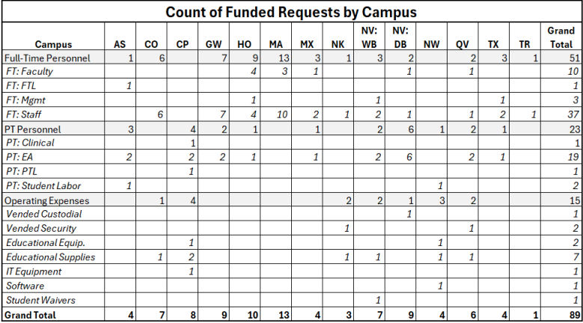
I. Midyear Plan to Reallocate Resources
A total of 159 recommendations were made: 89 directly funded in this plan, 9 addressed via technical adjustments in the midyear, 4 requests made by campuses are addressed via a statewide initiative & 3 were already funded in the FY 25 budget

Slide 7
I. Midyear Plan to Reallocate Funding Analysis
$5.2M, or 80.4% of Plan is for Personnel & Fringe Benefits
Funded Requests by Functional Area

Slide 8
I. Midyear Plan to Reallocate Resources
Although 54 requests were not funded at this time, CT State will continue to review and assess these requests.
Common themes emerged from the requests that require a more comprehensive college-wide vision, rather than considering individual requests.
Campus Public Relations & Marketing
Student Activities
Guided Pathways Staffing
Campus One-Stops
Facilities & Maintenance Staffing
Clerical Support
President Maduko charged CT State VPs and CEOs to engage with stakeholders to develop a comprehensive plan with various funding recommendations to address each of these issues. CT State will dedicate resources during FY 25 and the upcoming fiscal year to address these areas as more detailed plans emerge.

Slide 9
II. CSCU Hiring Freeze
Applies to all CSCU institutions for all FT & PT positions (faculty & staff)
CT State will implement the hiring freeze by maintaining its rigorous RTF process for reviewing all positions
Involves HR, Finance, ECR & Cabinet leadership to review all FT hires. (Similar process for PT hires by CEOs on campus)
Aligns hiring decisions with college’s mission & budget while upholding its commitment to diversity, equity & inclusion
With CSCU hiring freeze all positions must:
Be essential to maintaining institutional safety, community security or reputation management
Necessary for accreditation or legal requirements
Vacancies that significantly disrupt student support or essential operations
Enhance financial sustainability
Align with strategic priorities
All current searches will proceed as planned
In FY 24, CT State hired 102 FT employees & YTD in FY 25 CT State hired 90 FT employees

Slide 10
III. Academic Classroom Supplies
Based on campus feedback from town hall meetings, Provost & CFO launched a review of campus academic supplies/equipment
Goal is to:
Ensure adequate resources for Spring semester
Build a predictive budget model
Explore future economies of scale
Involves campus department chairs, program coordinators & lab assistants
Began with the Sciences- funds will be transferred to campus departments this week
Working on Allied Health- templates are out to campuses due back this week
Next area is studio arts

Slide 11
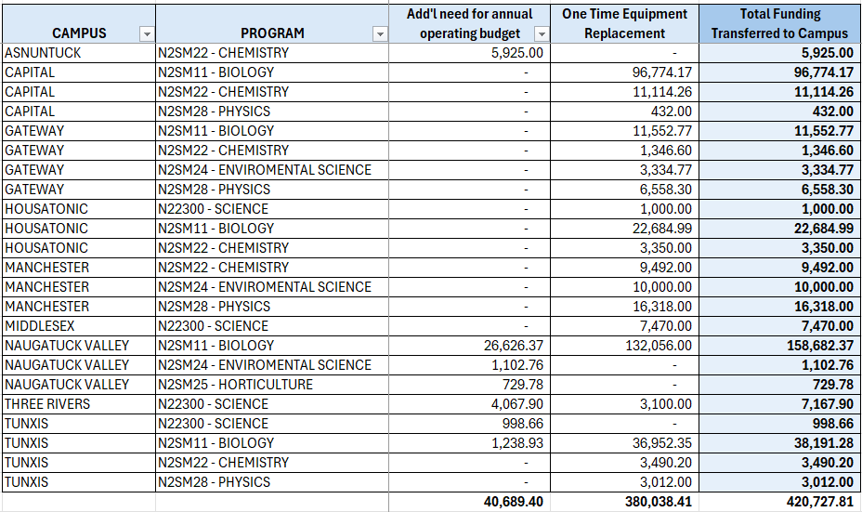
III. Distribution of Science Funds to Campuses
Note: Norwalk did not originally participate & subsequently received $25,506 for the Biology Department

Slide 12
IV. Governor’s Recommended Budget
Budget eliminates $79.6M in temporary support
Excerpt from OPM Budget Presentation to Appropriations Committee PowerPoint Presentation, page 30 of 58:
Additional appropriations do not necessarily defray loss of temporary support as funds presumes wage increases

Slide 13
V. Five Year Fiscal Sustainability Plan
Additional Constraints & Challenges
Maintain over 4.8 million gross sq.ft. at over 20 locations statewide
Deferred capital improvements/maintenance result in costly emergency repairs
Increased demand for student support services, particularly mental health & wrap around services
Inflationary pressures
Declining number of high school graduates in CT
High fixed costs, over 66% of budget is personnel costs

Slide 14
V. Five Year Fiscal Sustainability Plan
Builds from FY 25 mid-year forecast, incorporates improvement on the budget & annualizes it going forward
Assumes no tuition increase in FY 26 & FY 27
Assumes level enrollment – does not rely on risky assumptions
Assumes 3.5% inflationary increases in state block grants for FY 28-30
Does not close locations or facilities
Does not layoff collectively bargained staff
Does not assume closure of academic programs
Relies on utilization of reserves & future deficit mitigation targets to achieve balance

Slide 15
V. Five Year Fiscal Sustainability Plan
Strategies for Growth and Fiscal Sustainability
Expand economic activity in the state though workforce & non-credit partnerships
Increase Dual Enrollment Opportunities
Develop a Strategic Enrollment Plan
Enhance fundraising & targeted student supports
Increase efficiency of course offerings to achieve savings & better meet student needs
Continue financial improvements strategies while balancing student needs

Slide 16
APPENDICES

Slide 17
FY 25 College and Campus Budgets
CT State’s budget reported in 3 parts:
Shared Services is $40.2 million or 9%
System Office is $7.9 million or 2%
College (12 campuses & College Office) – 89%
Campus resources are understated as many things are budgeted centrally like:
Institutional Student Financial Aid: $15.6 million
Public Safety Officers
Library Materials
Financial Aid staff
Parts of Admissions/Enrollment
Insurance Costs
Marketing staff
Marketing Expenditures – $2.3 million
2,075 funded FT positions (permanent & temporary)
721 faculty
1,354 staff & administrators
4,969 funded PT positions (permanent & temporary)
3,137 adjunct & clinical faculty
563 non-credit lecturers
676 staff
593 student labor

Slide 18
System Reserves
Per BOT policy, the college may reserve up to 3% for contingency as designated reserves. CT State reserves provide 185 days of cash on hand.

Slide 19
FY 24 Variance from Original Budget (excludes SO/SS)
The FY 24 variance is attributable to:
Net Deficit Mitigation - $24.6M
Increases in Tuition and Fee Revenue due to a 3% enrollment gain over a flat enrollment assumption - $7.2M
Changes in Transfers from System Office - $3.7M
Improved Collections on overdue student accounts - $7.9M
Increases in All Other Revenue are due to higher interest rates realized on reserve fund balances - $13.4M
Delays in hiring in FY 24, despite hiring 178 full-time positions: Personal Services and Fringe Benefits savings - $15.5M
Reduced Other Expenses Spending - $10.8M
Re-estimate of Fringe Benefits - $10.6M

Slide 20
CT State is Transparent with Internal & External Stakeholders
Revenue projections made in January forecasted 94.2% of actual revenue & May forecast 97.6%
Overall expenditure projections made in January were 92.9% accurate and 94.6% accurate
Personnel & Fringe projections made in May were 97.0% accurate
Significant variance in projections for Other Expenses: 82% accurate in January & 83.7% in May
May projections made by the campuses for all other goods and services varied by 10-55% from actuals. Accordingly, CT State is strengthening its OE budget development and expense reporting/forecasting procedures.

Slide 21
